Slide 1



EMPLOYEE ATTRITION
ANALYSIS PROJECT
PRESENTATION BY
SANIYA SHAIKH

Slide 2



INTRODUCTION
Attrition in Human Resource terminology, refers to the phenomenon of the employees leaving the company. Attrition in a company is usually measured with a metric called attrition rate, which simply measures the number of employees moving out of the company.
The reduction in staff and employees in a company through normal means, such as retirement, resignation or death.
This is considered natural in any business and industry.
Attrition is also called Total Turnover or Wastage Rate.
Attrition is a problem that impacts all businesses, irrespective of geography, industry and size of the company.

Slide 3

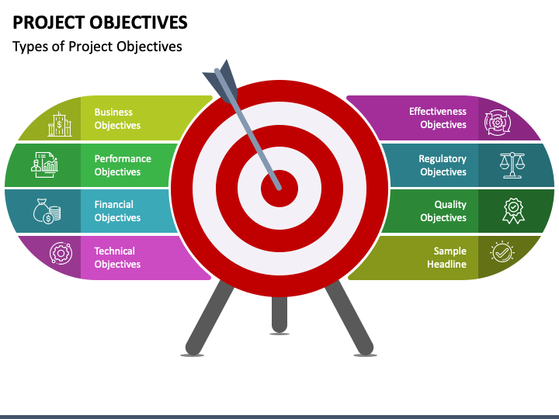

OBJECTIVE
To understand the factors central to attrition
To determine effect of attrition on the business
To understand the extend of job satisfaction among the employees
To suggest proper measures
Helping them to reduce employee’s attrition

Slide 4
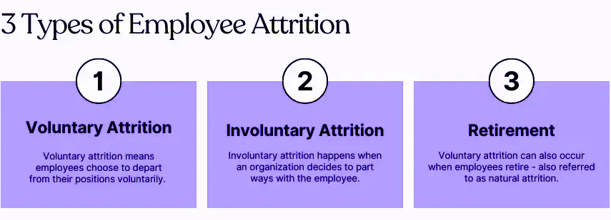

ATTRITION TYPES
Employee attrition categorizes it as either voluntary or involuntary. Involuntary attrition is thought of as the mistake of the employee and refers to the organization firing the employee for various reasons. Voluntary attrition is when the employee leaves the organization by his own will. Here we will focus on voluntary attrition. A meta- analytic review of voluntary attrition found that the strongest predictors of voluntary attrition included age, pay and job satisfaction. Other studies showed that several other features such as working conditions, job satisfaction and growth potential also contributed to voluntary attrition. Organizations try to prevent employee attrition by analyzing and using machine learning algorithms to predict risk of an employee leaving and then take pro-active steps for preventing such an incident.

Slide 5




WHY DO EMPLOYEES LEAVE ?
Lookup for Better Pay Options
Lack of Growth Opportunities
Lack of Appreciation and Motivation
No Hike in Salary
Unfair Compensation and Benefits
Uncooperative Team Members
Increased Work Hours
Health/Age Problems
Inability To Manage Pressure & Cope with Demands of Jobs
Bad Leadership and Incompetent Management
Personal Issues
Higher Studies, Immigration Abroad
Varied Career Aspirations

Slide 6
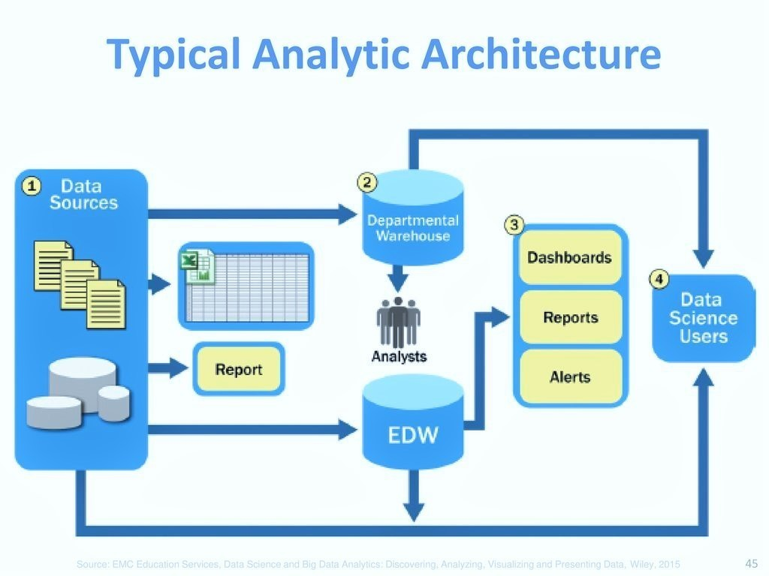




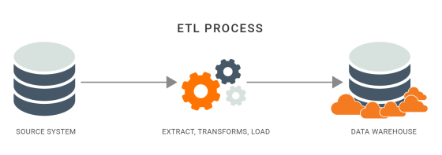

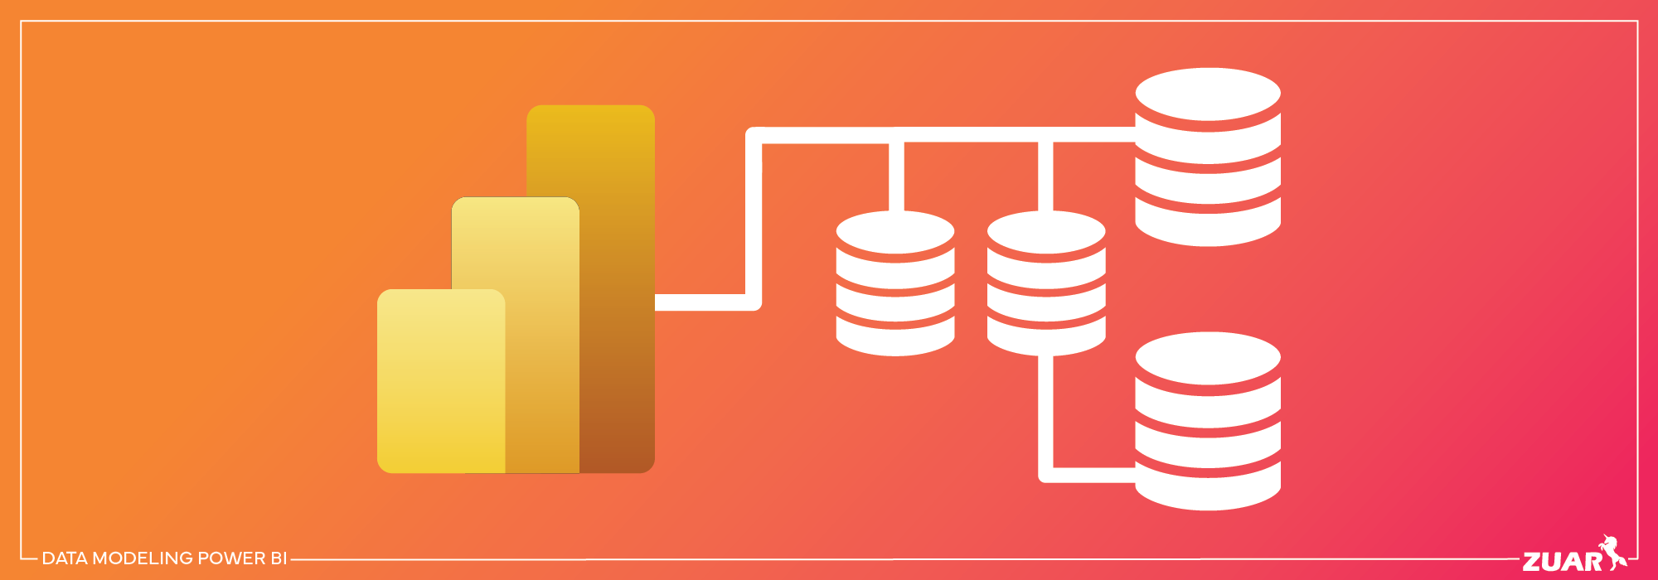




PROJECT ARCHITECTURE
Data Source
Power Bi
ETL Process
Presentation
Report Building
Data Modelling

Slide 7
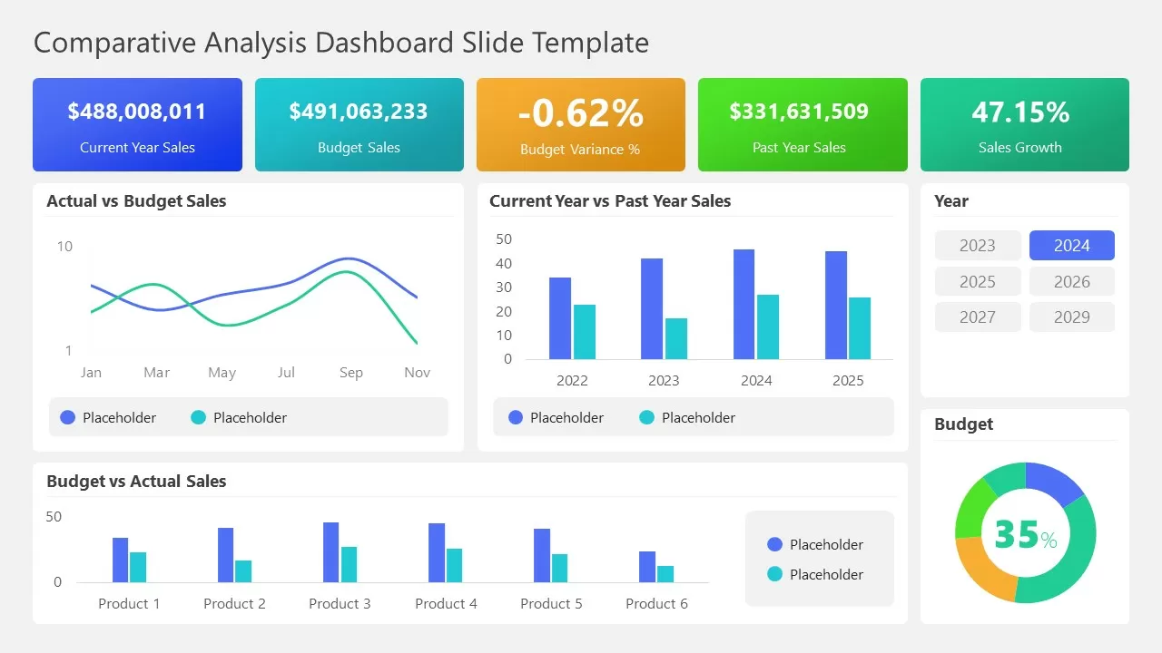
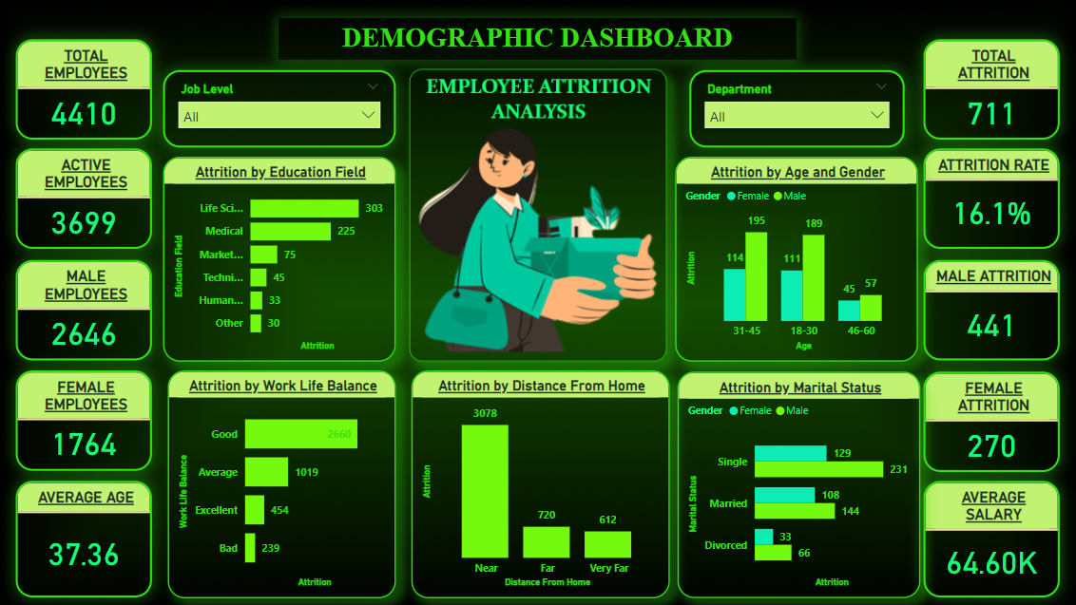

DASHBOARD- 1
DEMOGRAPHIC
Demographic dashboard summarizes employees statistics, including gender, work life balance, distance from home, education field, age groups and marital status providing insights into workforce diversity.

Slide 8
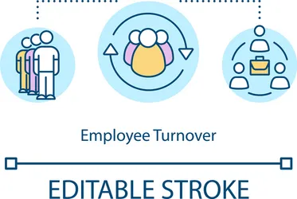
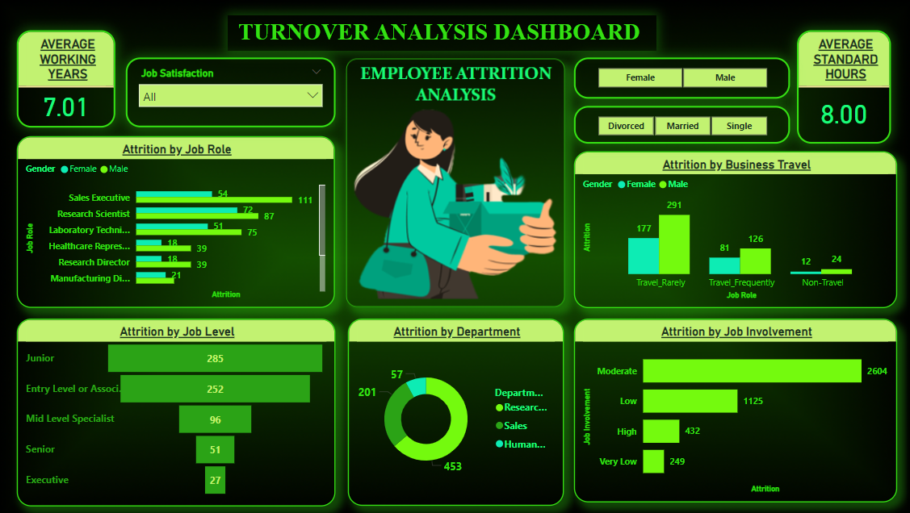
DASHBOARD-2
TURNOVER ANALYSIS
Turnover analysis dashboard provides insights into employee attrition including departures by department, job roles affected impact due to business travel and job involvement aiding in workforce management.

Slide 9
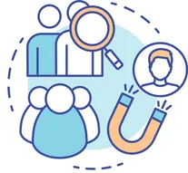
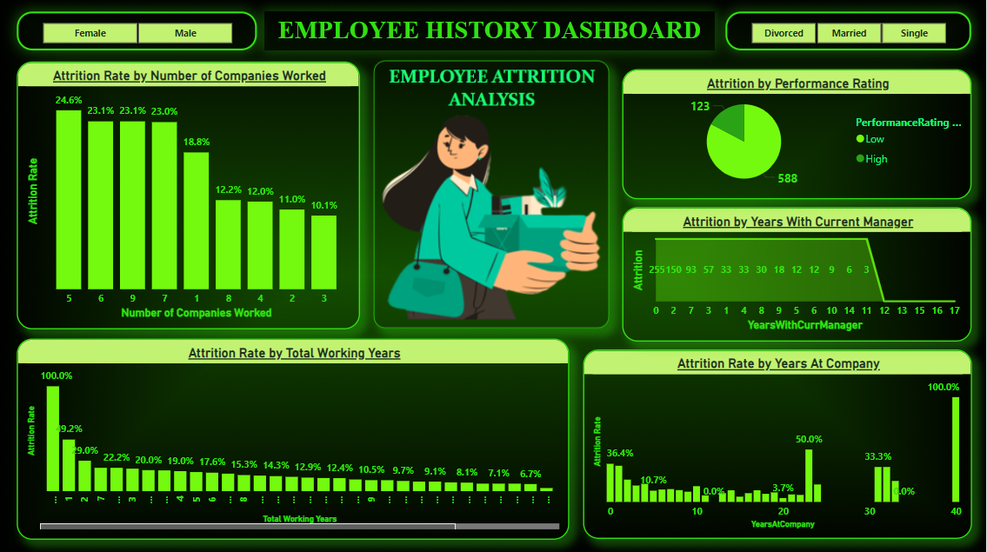
DASHBOARD-3
EMPLOYEE HISTORY
Employee History dashboard consolidates employee data featuring attrition by performance rating, number of companies worked, and also focuses on attrition rate by years at company, total working years and years with current manager offering critical insights for HR strategies.

Slide 10
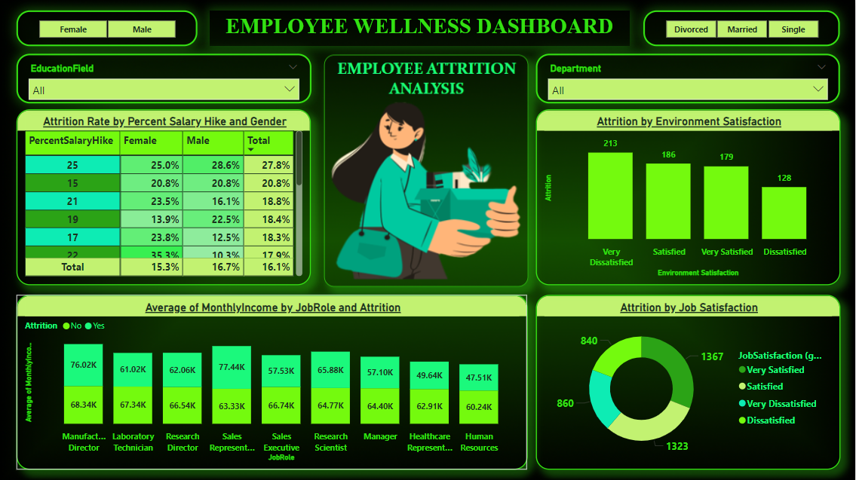
DASHBOARD-4
EMPLOYEE WELLNESS
Employee wellness dashboard provides insights into employee data featuring attrition by environment and job satisfaction monthly income by job role and percent salary hike as per gender offering necessary insight for effective decision making.

Slide 11
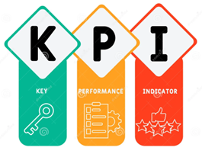

KEY PERFORMANCE INDICATORS
Total Number of Employees – 4410
Active Employee - 3699
Male Employees – 2646
Female Employees - 1764
Attrition Rate - 16.1%
Attrition Count - 711
Male Attrition – 441 Female Attrition – 270
Average Age – 37
Average Salary – 65k

Slide 12



INSIGHTS
Attrition by Gender : Males have highest Attrition Rate
Attrition by Department : Research and Development show the highest Attrition Rate.
Top 3 Job Roles with Highest Attrition Rate are Sales Executive, Research Scientist, Laboratory Technician
Employees give high priority to environment and job satisfaction, factors affecting attrition rate
Mostly Singles choose to depart from their jobs
Age Distribution : Majority of employees fall within 31-40 age range, & 18-30 and 46-60 age groups have least number of employees.
Job Level : Junior and entry level or associate have more attrition then other job levels.
Social Media Advertising
Influencer Marketing
Email Marketing Campaign

Slide 13



EFFECTS OF ATTRITION
Diminished Productivity
Loss of Knowledge & Experience
Loss of Clients and business associated with the departing employee
Negative Impact on team members
Excessive burden of workload to those left behind
Loss of revenue and increased cost of hiring new staff
Benefit to the competitor
Fall behind scheduled projects
Never ending cycle of hiring

Slide 14

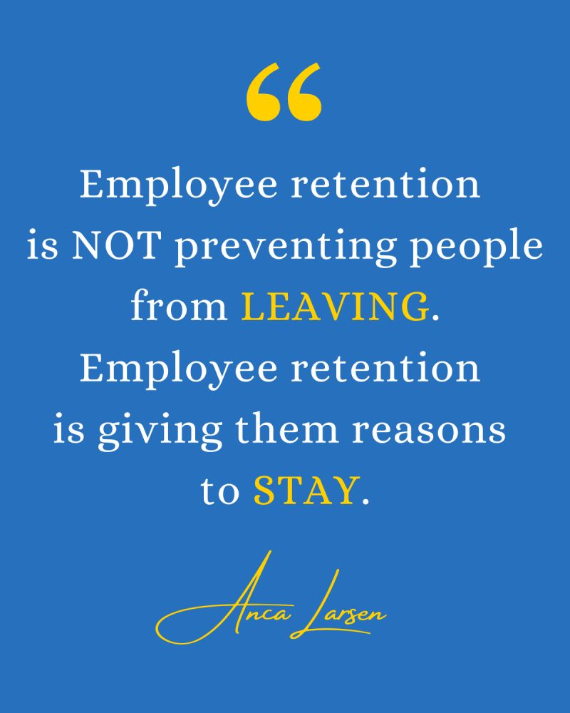

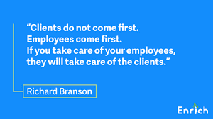
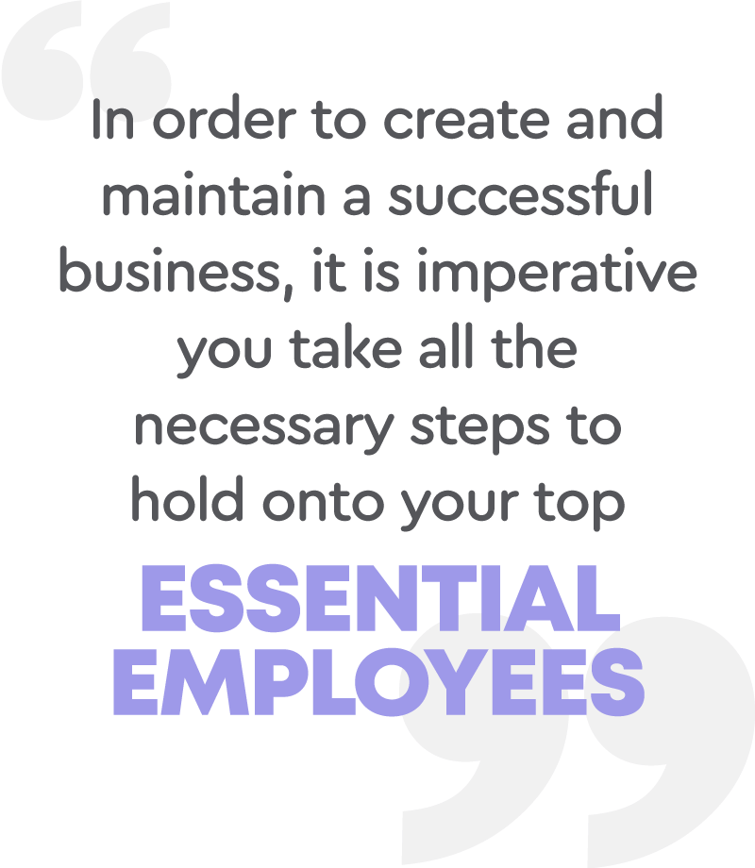
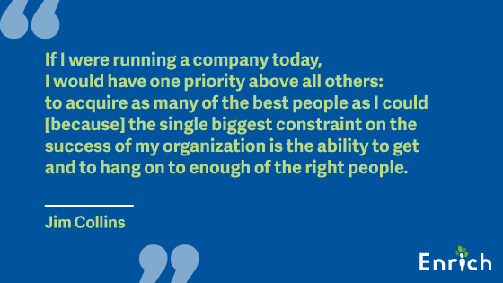

QUOTES

Slide 15
Thank you

